Slide 1
Monitoring the three 90’s, the next frontier: Cross-sectional Cascade to Client Centric Longitudinal Cascade
Dr Manish Bamrotiya
National Programme Officer
National AIDS Control Organization Ministry of Health & Family Welfare, Government of India

Slide 2
India HIV/AIDS Epidemic Status (2017)
Indicator | Global | India
People living with HIV (All ages) | 36.9 M | 2.14 M
New HIV Infections (All ages) | 1.8 M | 88,000
PLHIV on ART | 21.7 M | 1.23 M
AIDS-Related Deaths | 0.940 M | 69,000
HIV Prevalence (%) in different population groups
Low Prevalence Country (0.22%); concentrated epidemic
3rd Largest No. of PLHIV in the world
Female: 42% of PLHIV; Children: 3% of PLHIV
Source: HIV Sentinel Surveillance 2016-17, NACO

Slide 3
90-90-90 : Cross Sectional cascade

Slide 4
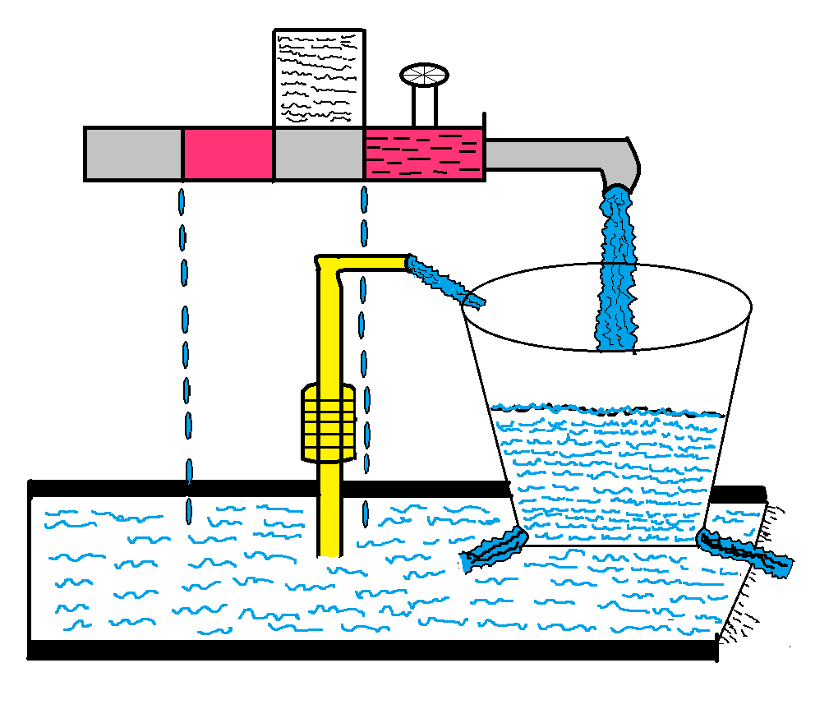
Real Picture - Dynamics impacting Cascade
Pre-ART
Screening
HCTS
ARTC
ART Initiation
Pre-ART Defaulter
Linkage loss
LFU Tracking
Second 9 (81% of total estimated)
Current Second 90 (58%)
LFU Pool
ART LFU
Deaths

Slide 5
Big Challenge at Every Stage

Slide 6
90-90-90 : Cross Sectional cascade
Cross-sectional representation of the progress on 90-90-90 at a particular point of time;
Provides the big picture for monitoring the progress by the programme managers/policy makers in a snap-shot
However
Less sensitive to reflect the impact of programmatic changes on a real time basis
Reflect the care continuum as a unidirectional; does not reflect dynamicity Detection → Linkage → Initiation →Retention → Suppression
Doesn't provide feedback on client specific care continuum

Slide 7
Moving Forward
Complementing Cross-Sectional Cascade with client centric longitudinal cascade using programme data

Slide 8
Client Centric Longitudinal Cascade through programme data
SIMS
Backbone of programme monitoring; individual data at facilities and electronic aggregation at higher level
PLHIV-ART Linkage System; Individual online tracking of HIV positive pregnant woman and her child up to 18 months. Now general clients also added
Inventory Management System; Online inventory management system at ART, extended to cover all details of PLHA
Paper Based Formats / Registers
EID
System to do the real time tracking of laboratory aspects of babies born to HIV +ve mother
TI Application; System to track the detailed information of each individual Key populations

Slide 9
PLHIV-ART Linkage System
At 6 weeks
At 6 months
At 12 months
At 18 months
General Individuals and Pregnant
women / Orphans visits to ICTC
centers for HIV testing
2
EID follow-up
1
6
If HIV + then register in PALS using Unique PID and referred to ART
4
Pregnant women further followed for Safe institutional Delivery
ARV prophylaxis monitoring
CPT initiation
PALS
Register
Continuum of care
5
ICTC Center
Pregnant Women
HIV positive infant/ Children
General individual
Lifelong treatment
9
Referral to ART center for treatment
If found +ve register as GC
Spouse/Partner HIV test
3
8
ART Center
If discordant Conduct follow-up HIV tests
7
10
Notes:
Integrated Counselling & Testing Center (ICTC) is the facility where an individual is tested for HIV with prior pre-test counselling and opt-out option.
An individual found HIV positive will be registered in PALS software & linked to the nearest Anti-retroviral treatment (ART) center for further investigation & treatment.
HIV positive pregnant women will be further followed up for the Safe institutional delivery and ARV prophylaxis initiation for baby.
Under Early infant diagnosis programme, a Continuum of care will be taken for infants born to HIV positive mothers
PALS also enables the tracking of Spouse/Sexual Partners of HIV positive individuals for prevention @ treatment services

Slide 10
Inventory Management System
Records Inventory Transactions
Suppliers
~15
LAC
1100+
SACS
35
ART
541
1,200,000+
Credit & Debit Inventory
PLHIV Treatment initiation, regimen and its dispensing, retention, viral load testing and vital events (death) details
Accountability, Transparency, Real Time

Slide 12
Key Learnings from the Cascades
What is being Monitored – Improves
One time Services (Linkage/ Initiation) improves faster
Cascade depends on Local Problems
Local Solutions required

Slide 13
Key Learnings from the Cascades
Now diagnosing people earlier and healthier
Linkage loss is being plugged to some extent over time.
Retention is still a major challenge.
Significant Facility and Geographical variations

Slide 14
Challenges to programme based longitudinal cascade Surveillance
Multiplicity of systems serving specific need but not tracking through out the prevention – care – cascade
Different Systems, different IT platforms, interoperability challenging
Transitioning from paper based to digitalized system
Unique Identifier

Slide 15
Next Steps for Programme based longitudinal cascade Surveillance (1)
Client centric IT enabled integrated MES system with embedded supply-chain management information
Know your Epidemic
Prevalence
Inputs
Finance
Outputs & Outcome
Impact
New Infection
Mortality
Prevention
Detection
Treatment
Retention

Slide 16
Next Steps for Programme based longitudinal cascade Surveillance
Feedback Oriented Client Centric IT enabled Integrated Monitoring, Evaluation and Surveillance System under GFATM Grant

Slide 17
Acknowledgement
Shri Sanjeeva Kumar, AS & DG
Shri Alok Saxena, JS
Dr R S Gupta, DDG
Dr K S Sachdeva, DDG
Dr Pradeep Kumar, PO
Dr Suman Singh, PO
Ms Mariyam Zanib, PO
Mr Archit Sinha, PO
Facility and State level colleagues

Slide 18
Thank You

